Slide 1
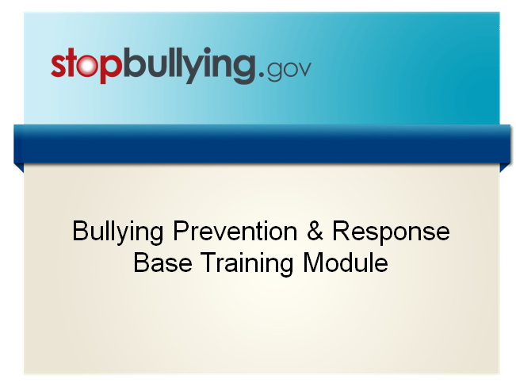

Slide 2
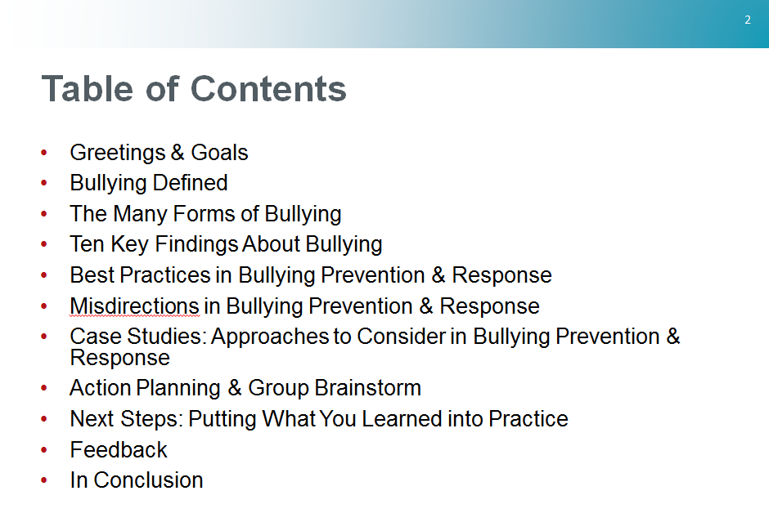

Slide 3

Notes:
Welcome to today’s bullying prevention and response training.
As you know, bullying is a serious problem affecting youth in communities all across America, and all adults have a role in helping to stop it. We have gathered for this training so that each individual in this room has a better understanding of bullying and is equipped with the tools and resources to take action. Specifically, this training provides you with guidance to hold a community event – such as a town hall meeting - to activate your community in bullying prevention.
When you leave here today, our goal is to successfully communicate:
The definition of bullying, the many forms it takes, and its effects
Best practices in preventing bullying and responding when you see bullying happen
Compelling examples of what works
How to create an action plan and execute your community event
We will also provide you with a Community Action Toolkit that offers guidance and research-based resources to make it as easy as possible to get started and make a difference. You will notice that many of the resources have been tailored for our profession and the work that we do.
During this training, you will become familiar with many of the resources developed by the Federal Partners in Bullying Prevention, representing leaders in the federal government working together to make sure communities have what they need to combat bullying.
This project was funded by the U.S. Department of Health and Human Services (HHS), Health Resources and Services Administration (HRSA).
Let’s begin our training by reviewing the definition of bullying.

Slide 4
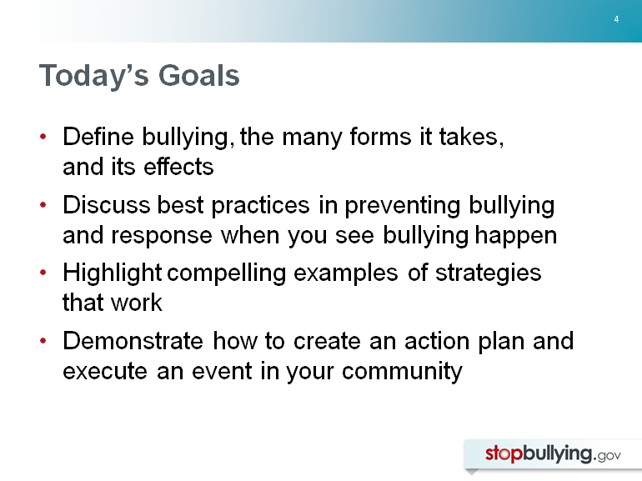
Notes:
Our goal is to successfully communicate the following, so that you leave here today prepared to:
Define bullying, the many forms it takes, and its effects
Discuss best practices in bullying prevention and responding to bullying that occurs
Highlight compelling examples of strategies that work
Create an action plan and execute your community event

Slide 5
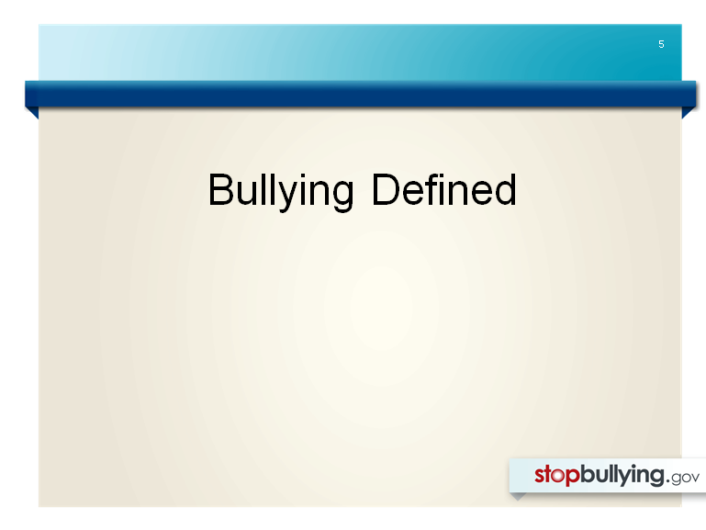

Slide 6
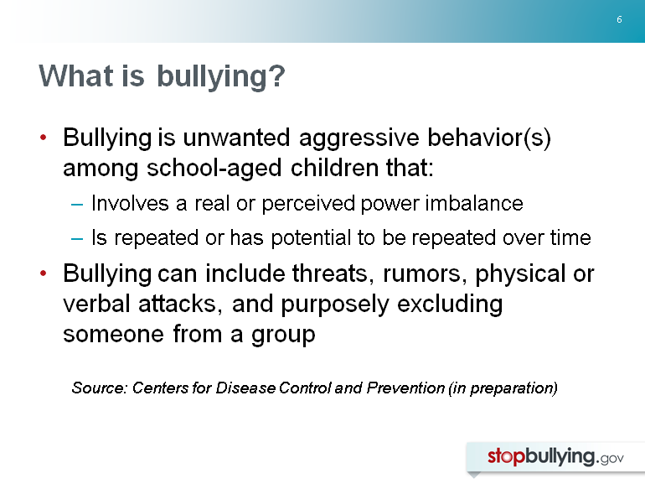
Notes:
This is the full definition of bullying from StopBullying.gov:
Bullying is unwanted, aggressive behavior among school aged children that involves a real or perceived power imbalance. The behavior is repeated or has the potential to be repeated, over time. Both kids who are bullied and who bully others may have serious, lasting problems.
In order to be considered bullying, the behavior must be aggressive and include:
An Imbalance of Power: Kids who bully use their power—such as physical strength, access to embarrassing information, or popularity—to control or harm others. Power imbalances can change over time and in different situations, even if they involve the same people.
Repetition: Bullying behaviors happen more than once or have the potential to happen more than once.
Bullying includes actions such as making threats, spreading rumors, attacking someone physically or verbally, and excluding someone from a group on purpose.

Slide 7
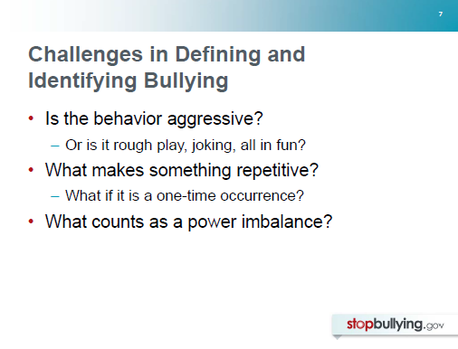
Notes:
Researchers, practitioners, and policymakers face a number of challenges in defining bullying and knowing how to identify it. Let me highlight some of these challenges briefly and then come back to discuss them in more detail.
A first challenge has to do with identifying—often on the spot—if behavior that occurs in a school’s hallways, cafeteria, or on a playground is aggressive or if it is rough play…all in fun.
A second challenge involves the repetitive nature of bullying. What makes something repetitive? And can a behavior be considered bullying if it occurs only once?
A third challenge is understanding what counts as a power imbalance among children.

Slide 8
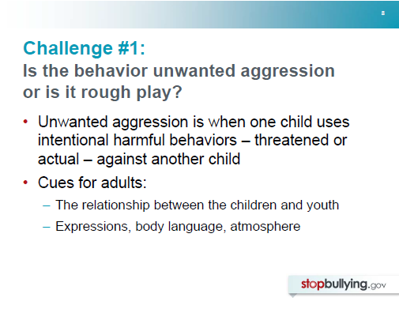
Notes:
Let’s look at that first challenge. How can we determine if a behavior is bullying or simply rough play, which is common, particularly among younger boys?
As mentioned earlier, an important step in defining bullying is that it must be unwanted aggressive behavior—which is often defined as the intentional use of harmful behaviors against another child. These behaviors may be threatened or real.
How can we tell on the playground or in the hallways if behavior is actually aggressive, or if it’s just “play”?
We can’t always rely on children to tell us what’s really going on, since children who bully may often explain their behavior as “just messing around” or “all in fun.” Rather, we have to look for cues to help—such as how the children involved relate to each other:
Are they long-standing friends or do they have a history of issues between them?
What are their expressions and body language? Does it look like both are having fun, or is one showing obvious or subtle signs of distress?
When in doubt, it is important to follow up—especially if you don’t know the children well. And of course, even if a behavior you observe isn’t bullying, it still may not be acceptable in a school or other setting.

Slide 9
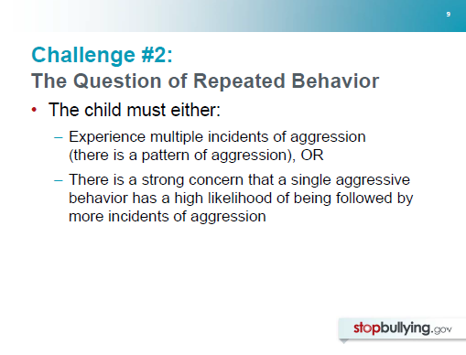
Notes:
Bullied children typically experience multiple incidents—or a pattern of aggression against them.
But according to the CDC, bullying also may exist if there is a high likelihood that the behavior will be repeated.
Just because bullying typically is repeated over time doesn’t mean that a one-time instance isn’t bullying or that adults should wait for a pattern to emerge before responding.

Slide 10
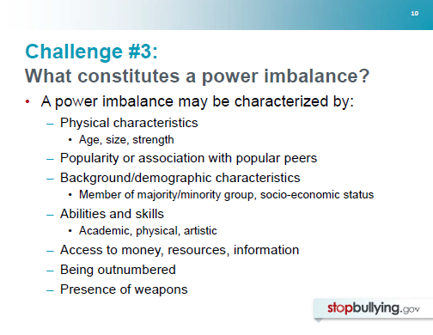
Notes:
Power imbalances can be characterized by physical differences between children, such as age, size, and strength. But they need not be physical. Power can also be characterized by:
Popularity
Background/demographic characteristics (such as whether or not a child is a member of a majority racial or ethnic group, whether he or she has a high socio-economic status, whether he is in the majority regarding sexual orientation)
By social, academic, physical or other skills or abilities
Or by access to money, resources, or information—such as being able to reach an entire student body with a single e-mail button
One also can exert power over others by outnumbering them (for example, having a group of friends join in the bullying of a single child) or by having a weapon.

Slide 11
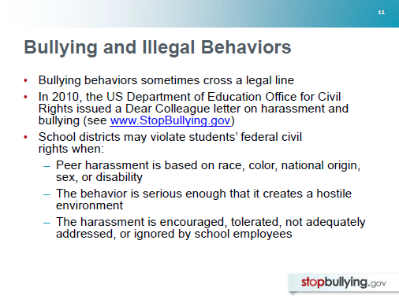
Notes:
There is also sometimes confusion over what happens when bullying behaviors cross a legal line. Some bullying behaviors may also meet the legal definition of harassment or assault. Remember though, not all incidents of harassment or assault are bullying, and not all bullying involves harassment or assault.
The US Department of Education’s Office for Civil Rights issued a Dear Colleague (DCL) letter on harassment and bullying in late October 2010. You can access the full letter on StopBullying.gov. We will discuss this issue more in-depth later in the presentation.
Now let’s take a close look at some cases of harassment that are illegal under federal law.
The DCL highlights that discriminatory harassment may include harassment or bullying that is grounded in race, color, national origin, sex, or disabilities. Current laws do not protect against harassment based on religion or sexual orientation, but they do include protection against harassment of members of religious groups based on shared ethnic characteristics as well as sexual harassment of LGBT individuals.
The message to school personnel is that they must carefully consider whether bullying behavior is discriminatory harassment that violates students’ federal civil rights. Under federal law, school personnel have very clear obligations to investigate immediately in such circumstances and to take prompt steps to end the harassment if it occurred.

Slide 12
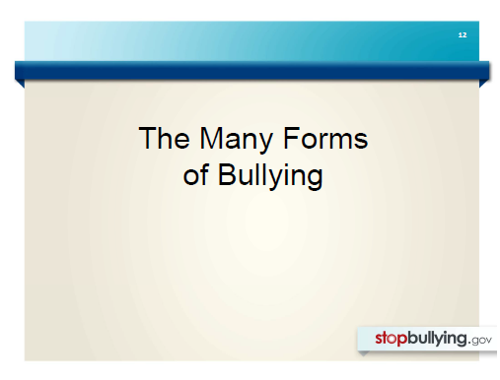

Slide 13
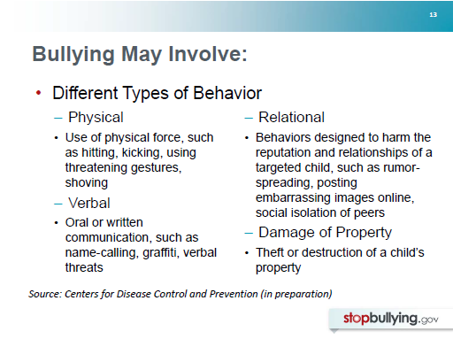

Slide 14
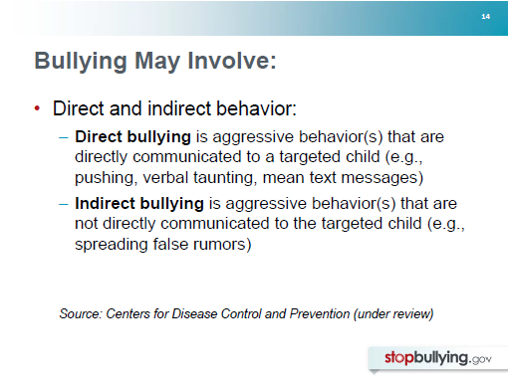

Slide 15
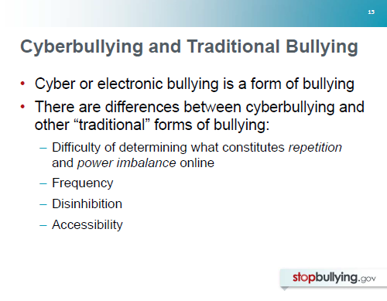
Notes:
The internet and electronic devices have provided a new context in which bullying can occur.
Most experts agree that cyberbullying (or electronic bullying) is best understood as a type of bullying—it is unwanted aggressive behavior that occurs online or through the use of electronic devices that involves repetition and a power imbalance.
There are some notable differences between cyberbullying and many other “traditional” types of bullying:
It is difficult to define what repeated aggression or a power imbalance means in the electronic context, which makes it difficult to distinguish electronic aggression from electronic bullying. For example, should forwarding a nasty e-mail be considered repeated aggression? If a message or posting is anonymous, does that automatically constitute a power imbalance?
Children and youth are less likely to experience cyberbullying than many other types of bullying, such as face-to-face verbal bullying or physical bullying.
Children and youth may find it easier to say or do mean things online or through electronic devices that they would not do face-to-face.
Whereas children and youth typically experience traditional forms of bullying during the school day or in after-school or community activities, they may experience cyberbullying 24/7.

Slide 16
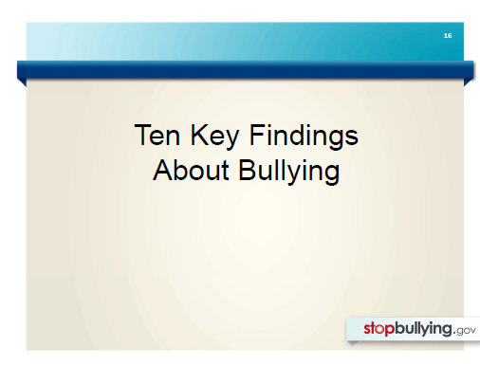
Notes:
With a common understanding of what bullying is (and isn’t), I’d like to move to a discussion of what we know about bullying. In the last decade, there has been a large increase in research on bullying among children and youth. In the next 30 minutes or so, I’d like to share 10 key findings from this research with you.

Slide 17
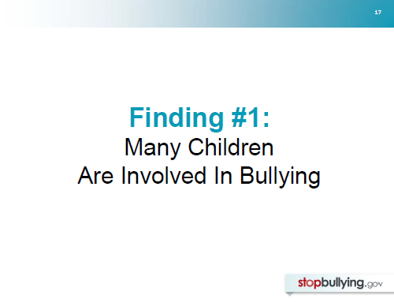
Notes:
The first finding is that many children are involved in bullying. Let’s take a look at what we know about the prevalence of bullying.

Slide 18
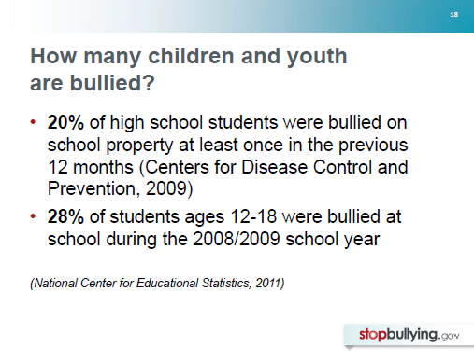
Notes:
Additional Information:
National estimates of bullying vary and depend on such variables as the definition used, the age of the study participants, and the time frame examined. However, studies are consistent in showing that substantial percentages of children are involved as aggressors, victims of bullying, or both.
For example, according to the 2009 Youth Risk Behavior Survey published by the Centers for Disease Control, 20% of high school students (grades 9-12) had been bullied on school property at least once in the previous 12 months.
Another national survey, the School Crime Supplement to the National Crime Victimization Survey, reported that 28% of students ages 12-18 had been bullied at school during the 2008/2009 school year.
References:
Cook, Williams, Guerra, & Kim (2010)
Centers for Disease Control and Prevention (2009)
National Center for Educational Statistics (2009)

Slide 19
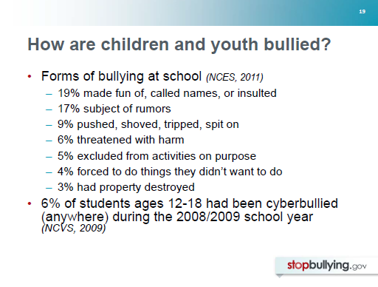
Notes:
Additional Information:
This same survey of 12-18-year-olds examined different types of bullying that students had experienced: The most common form of bullying was verbal--19% of 12-18 year-olds said they had been made fun of; 17% had been the subject of rumors; 9% had been pushed, shoved, tripped, or spit on; 6% had been threatened with harm; 5% had been excluded from activities; 4% had been forced to do things they didn’t want to do; and 3% had property destroyed.
The study also asked students how often they had been cyberbullied anywhere (i.e., not just at school) during the 2008-2009 school year. 6% had cyberbullied at least once. The most common form of cyberbullying involved unwanted contact through text messaging (3%, followed by: hurtful information sent over the Internet [2%], unwanted contact through Instant Messaging [2%], unwanted contact through email [1%], unwanted contact through online gaming [1%], and purposeful exclusion from an online community [1%]).
Reference:
National Center for Educational Statistics (2009)

Slide 20
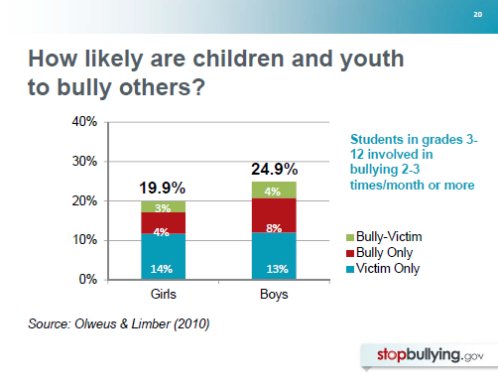
Notes:
Additional Information:
As mentioned earlier, students are involved in bullying not only as victims of bullying. They also may bully others, or they may bully others AND also be bullied themselves. (These children and youth are often referred to as bully-victims). In a recent study of more than 520,000 3rd-12th graders from 1,593 schools across the U.S., researchers found that overall 20% of girls and 25% of boys had been involved in bullying on a regular basis (2-3 times/month or more often).
As you can see, students report that it is somewhat more likely that they are bullied (light blue bar) than bully others (red bar). Relatively small percentages of students were classified as bully-victims (green bar, 4% of boys and 3% of girls).
Reference:
Olweus & Limber (2010)

Slide 21
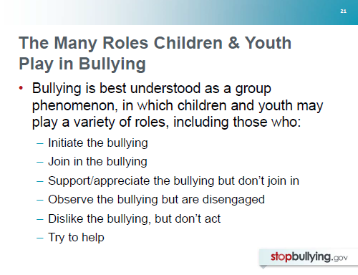
Notes:
Additional Information:
Although adults often view bullying as a problem between two children (a child who bullies and his or her target or victim), bullying is more accurately understood as a group phenomenon in which children may play a variety of roles, such as those listed here. Some initiate the bullying, while others are quick to join in.
In addition to these children and youth who bully, research confirms that many more (two-thirds of all students surveyed in several studies) witness bullying. These witnesses (who are sometimes referred to as “bystanders”) may play a variety of roles as well. They may support the bullying that they observe through laughter or smiles, or body language; they may watch but feel disengaged; they may dislike the bullying that they observe but feel reluctant to take action against it; or they may try to help in some way.
References:
Olweus (1993)
Rivers, Poteat, Noret, & Ashhurst (2009)
Trach, Hymel, Waterhouse, & Neale (2010)

Slide 22
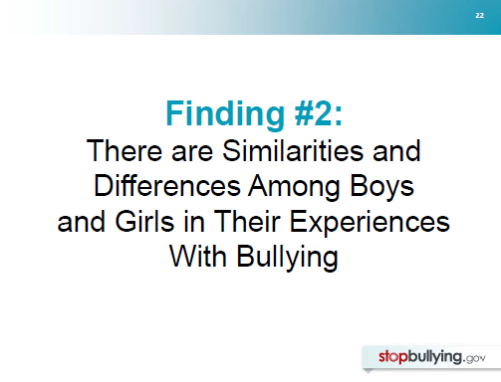
Notes:
The second key finding is that there are both similarities and differences in boys’ and girls’ experiences with bullying.

Slide 23
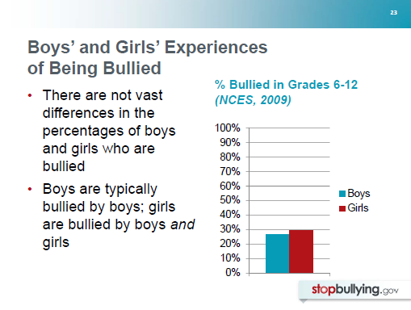
Notes:
Additional Information:
Most studies find either small differences or no differences in the likelihood that boys and girls are bullied. For example, in the National Crime Victimization Survey, 27% of boys reported that they had been bullied at school during the 2008-2009 school year, while 30% of girls said they had been bullied.
Important gender differences do emerge, however, in the relationship between those who are bullied and their aggressors. Boys most commonly are bullied by other boys, while girls report being bullied by boys and girls.
References:
Centers for Disease Control and Prevention (2009)
Cook, Williams, Guerra, & Kim (2010)
National Center for Educational Statistics (2011)
Olweus (2010)

Slide 24
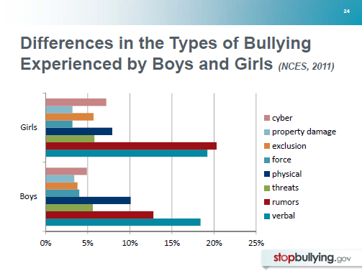
Notes:
Additional Information:
There also are some interesting similarities and differences in the types of bullying that boys and girls experience:
As the National Crime Victimization Survey (2009) reveals, boys and girls experience similar rates of:
Verbal bullying (dark blue bar)
Threats (green bar)
Damage to property (light blue bar)
Boys are more likely to experience:
Physical bullying (purple bar)
Girls are more likely to experience:
Bullying through rumor-spreading
Exclusion (orange bar)
Cyberbullying (pink bar)

Slide 25
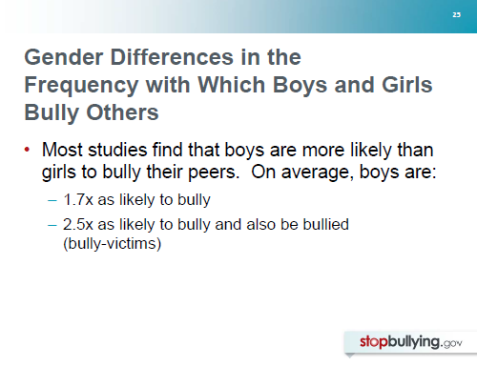
Notes:
Additional Information:
Most research has found that boys are more likely than girls to bully their peers. A recent analysis of 82 studies (Cook et al., 2010) found that on average, boys are 1.7 times as likely as girls to bully and are 2.5 times as likely to be bully-victims (i.e., to bully and also be bullied).
References:
Cook, Williams, Guerra, & Kim (2010)
Craig et al. (2009)
Currie et al. (2004)
Nansel et al. (2001)
Olweus & Limber (2010)

Slide 26
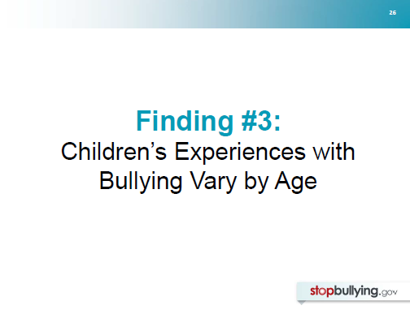
Notes:
Children’s experiences with bullying don’t only vary depending on their gender. They also vary with age.

Slide 27
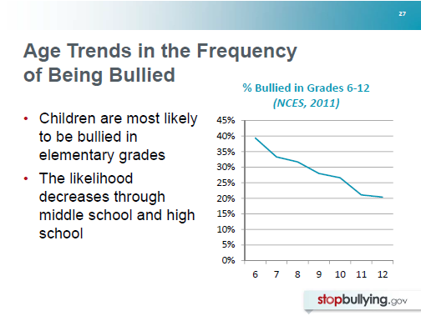
Notes:
Children and youth are most likely to be bullied in elementary school. Anonymous self-report surveys of children and youth indicate that the likelihood that they will be bullied decreases steadily through middle school and high school.
Additional Information:
Here, you can see data from the National Crime Victimization Survey, which assessed the frequency with which middle and high school youth were bullied during the 2008/2009 school year.
References:
Finkelhor, Ormrod, Turner, & Hamby (2005)
Nansel et al. (2001)
National Center for Education Statistics (2011)
Olweus & Limber (2010)
Guerra, Williams, & Sadek (2011)
Rigby (2002)

Slide 28
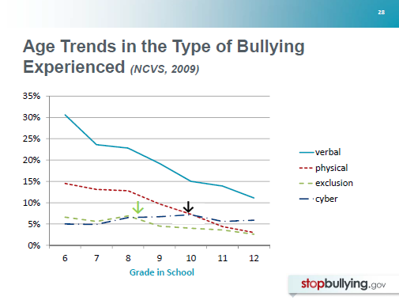
Notes:
With age, children and youth report decreases in many forms of bullying (such as verbal bullying, and physical bullying shown here, but also rumor-spreading).
Additional Information:
For other forms of bullying, we see somewhat different trends.
For example, youth are most likely to report being excluded (green line), having property damaged or destroyed, or being forced to do things they didn’t want to do in late middle school (green arrow); they are most likely to report being cyberbullied in high school (black arrow).
Reference:
National Center for Education Statistics (2011)

Slide 29
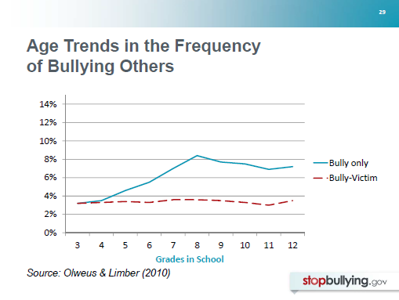
Notes:
Bullying of others (blue line) tends to increase during the elementary grades, peak in early adolescence, and decrease somewhat in high school grades.
Children’s experiences of both bullying others and being bullied (referred to as “bully-victims”) remain fairly steady with age.
References:
Guerra, Williams, and Sadek (2011)
Olweus & Limber (2010)
Nansel et al. (2001)

Slide 30
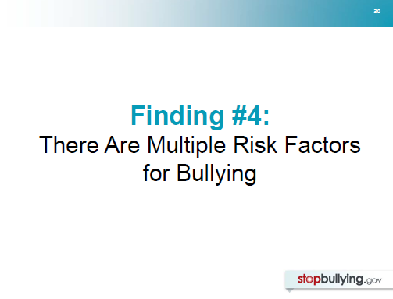
Notes:
A fourth key finding from research is that there is not one single cause of bullying. There are many different factors that place children and youth at risk for being involved in bullying.

Slide 31
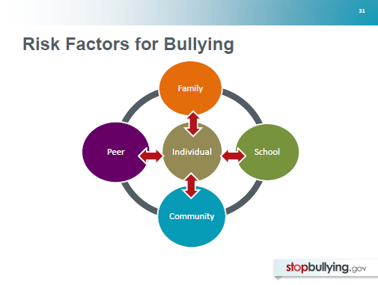
Notes:
Another way of saying this is that bullying results from a complex interaction between individuals and their broader social environment, including their families, their peers, their school, and community.
References:
Kowalski, Limber, & Agatston (2008)
Swearer & Doll (2001)
Swearer, Espelage, Koenig, Berry, Collins, & Lembeck (2012)

Slide 32
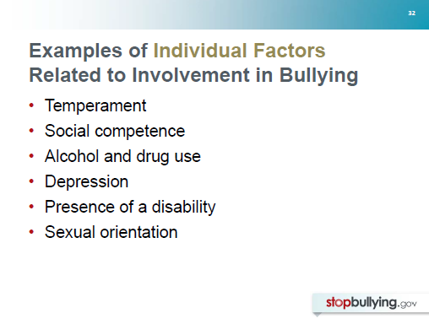
Notes:
Research has confirmed that there are individual factors or variables that are related to a child or adolescent’s involvement in bullying.
Additional Information:
Individual temperament may play a role. Children and youth who bully are more likely to have an active, “hot-headed” temperament, while children who are bullied are more likely to have a quiet, passive temperament.
The social competence of children and youth is also related to involvement in bullying. Children who are bullied (and particularly bully-victims), for example, are more likely than their peers to lack social skills.
Children and youth who are involved in substance use—alcohol, drugs, cigarettes—are more likely to be involved in bullying. Bully-victims are particularly likely to use alcohol and drugs.
As we’ll discuss in more detail in a few minutes, children and youth are more likely to be bullied if they are depressed, if they have a disability, or if they are gay, lesbian, bisexual, transgender or if they are questioning their sexual identity.
References:
Cook, Williams, Guerra, Kim, & Sadek (2010)
Olweus (1993)
Reijntjes, Kamphuis, Prinzie, & Telch (2010)
Swearer et al. (2012)

Slide 33
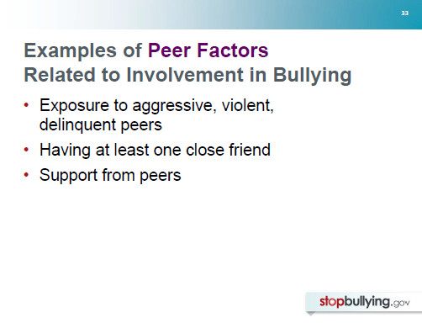
Notes:
There also are important peer factors that make it more or less likely that a child or adolescent will be involved in bullying. The peer group is a particularly important influence during adolescence.
Additional Information:
Research has shown that exposure to aggressive, violent, or delinquent peers may increase the likelihood that child or adolescent will bully others.
Of course, peers can also have positive or protective influences. Children and youth who are bullied tend to be socially isolated. Research has found that those who have at least one friend are less likely to be bullied.
Not only having a friend but feeling supported by peers is important. For example, children and youth who feel supported by their peers are less likely to experience negative psychological effects from bullying that they experience.
References:
Cook, Williams, Guerra, Kim, & Sadek (2010)
Hodges, Boivin, Vitaro, & Bukowski (1999)
Olweus (1993)
Swearer et al. (2012)

Slide 34
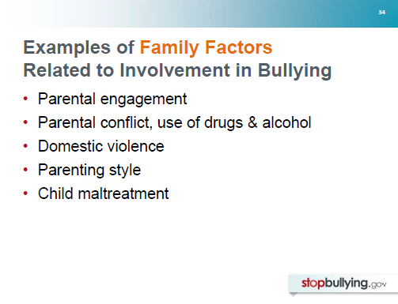
Notes:
Many family variables are related to children’s involvement in bullying. A number of examples are listed here.
Additional Information:
Having disengaged parents increases the risk that a child will bully others, while having warm, involved parents reduces this risk.
Exposure to parental conflict, parental use of drugs & alcohol, and domestic violence increases the likelihood that a child will bully others and the likelihood that a child will be bullied.
Children whose parents adopt parenting styles that are authoritative (that permit independence but also set limits and are responsive to their child’s needs) are less likely to be involved in bullying. On the other hand, parents who are overly permissive and those who use overly harsh discipline strategies are more likely to have children who bully.
Child abuse has been found to be related to a greater likelihood of bullying others and also being bullied by peers.
References:
Baldry (2003)
Bowes, Arseneault, Maughan, Taylor, Casi, & Moffitt (2009)
Olweus (1993)
Pellegrini (1998)
Swearer, Espelage, Koenig, Berry, Collins, & Lembeck (2012)

Slide 35
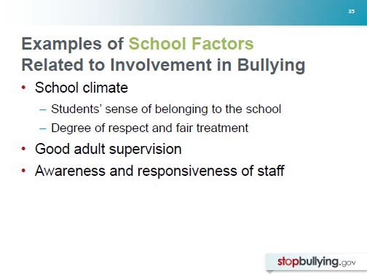
Notes:
Factors within the school environment are also related to the likelihood of bullying.
Additional Information:
Variables related to school climate have been found to be important. For example, having a sense of belonging to one’s school is associated with less involvement in bullying (bullying others and being bullied).
The degree to which staff actively supervise behavior, are aware of bullying issues, and are responsive to bullying problems is also critical.
References:
Cook, Williams, Guerra, Kim, & Sadek (2010)
Olweus (1993)
Pellegrini & Bartini (2000)
Swearer, Espelage, Koenig, Berry, Collins, & Lembeck (2012)

Slide 36
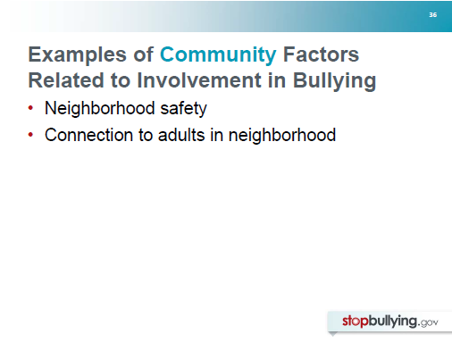
Notes:
Finally, factors within the larger community are also related to the likelihood of bullying.
Additional Information:
For example, research has found that children and youth from safe neighborhoods, who report that they are known by adults, are less likely to bully others and also less likely to be bullied.
References:
Cook, Williams, Guerra, Kim, & Sadek (2010)
Swearer, Espelage, Koenig, Berry, Collins, & Lembeck (2012)

Slide 37
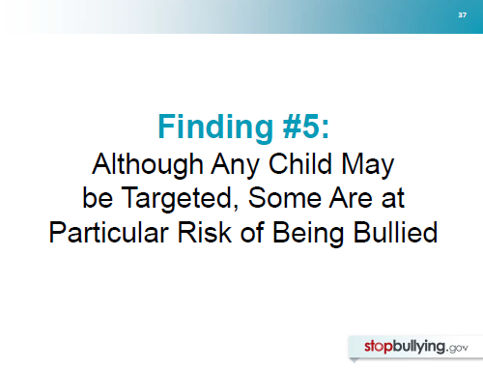
Notes:
A fifth key finding is that any child or youth may be bullied by peers, but some groups of children and youth are at a particularly high risk of being bullied.

Slide 38
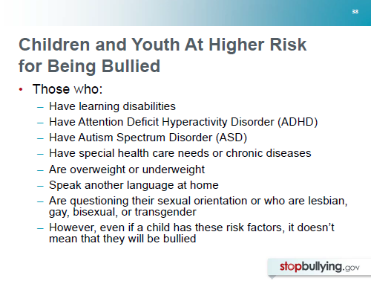
Notes:
No single factor puts a child at risk of being bullied or bullying others. Bullying can happen anywhere—cities, suburbs, or rural towns. Depending on the environment, some groups—such as
Lesbian, gay, bisexual, or transgendered (LGBT) youth, youth with disabilities, and socially isolated youth—may be at an increased risk of being bullied.
Children and youth with learning disabilities are at greater risk of being teased and physically bullied, compared with other children;
Those with ADHD are more likely to be bullied (and also to bully their peers);
Those with Autism Spectrum Disorder are more likely to be ostracized;
Children and youth with special health care needs or chronic diseases (diabetes, muscular dystrophy, spina bifida, atopic eczema) are more frequently bullied;
Overweight and obese youth, and those who are underweight may be more likely to be bullied;
Students who speak another language at home are more likely to be frequently bullied because of their religion or race than those who speak English.
And finally, children and youth who are questioning their sexual orientation or who are lesbian, gay, bisexual, or transgender report experiencing higher levels of verbal bullying as well as physical and relational aggression.
References:
Gray, Kahhan, & Janicke (2009)
Hamiwka, Yu, Hamiwka, Sherman, Anderson, & Wirrell (2009)
Harris Interactive and GLSEN (2005)
Kosciw, Diaz, & Greytak (2008)
Magin, Adams, Heading, Pond, & Smith (2008)
Martlew & Hodson (1991)
Mepham (2010)
Mishna (2003)
Storch et al. (2004)
Twyman, Saylor, Saia, Macias, Taylor, & Spratt (2010)
Wang, Iannott & Luk (2010)
Wiener & Mak (2009)

Slide 39
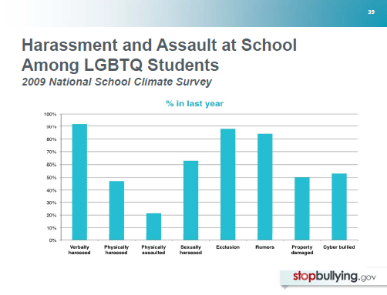
Notes:
In a survey of 7,261 students ages 13-21 throughout the U.S. who identified themselves as lesbian, gay, bisexual, or transgender or who were questioning their sexual identity, very high percentages reported being sexually harassed and bullied in the last year:
92% had been verbally harassed in the last year, and 85% of these said it was because of their sexual orientation
47% had been physically harassed (shoved or pushed)
22% had been assaulted at school (punched, kicked or injured with a weapon), most commonly because of their sexual orientation or gender expression
68% had been sexually harassed at school (e.g., unwanted touching or sexual remarks directed at them), one-fifth said this happened often or frequently
88% had felt deliberately excluded or left out by other students (half experienced this often or frequently)
Most (84%) had rumors or lies told about them at school (1/3 often or frequently)
Half reported that their property had been stolen or purposefully damaged by other students at school in the past year (1/10 often or frequently)
Reference:
Kosciw et al. (2008)

Slide 40
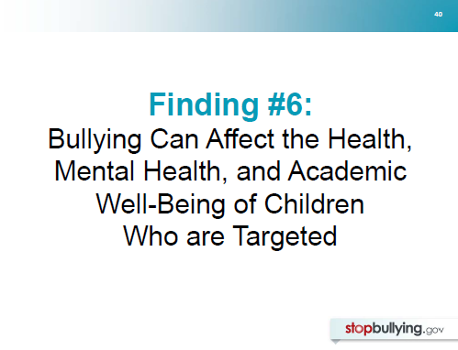
Notes:
The sixth finding relates to the known effects of bullying on the health, mental health, and academic well-being of children and youth who are bullied.

Slide 41
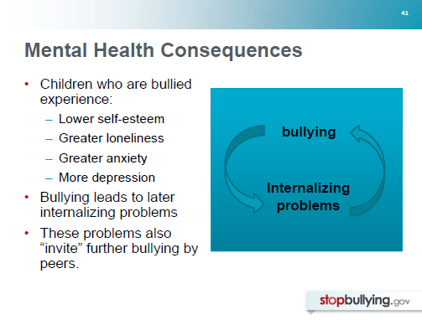
Notes:
Over the last decade, many studies have found that children and youth who are bullied are more likely than non-bullied peers to suffer from low self-esteem, loneliness, anxiety, and depression.
Additional Information:
In recent years, researchers have worked to understand whether bullying leads to such problems, or whether these problems precede the bullying and possibly make it more likely that a child will be bullied. The conclusion is that children’s experiences of being bullied do lead to later internalizing problems, such as low self-esteem, loneliness, anxiety, depression. But it also is true that having these issues, in turn, invite further bullying by peers. So, often, children and youth may become caught in a vicious cycle of bullying by peers that is difficult to escape.
References:
Hawker & Boulton (2000)
Juvonen, Graham, & Schuster (2003)
Fekkes et al. (2004)
Reijntjes, Kamphuis, Prinzie, & Telch (2010)
Undheim & Sund (2010)

Slide 42
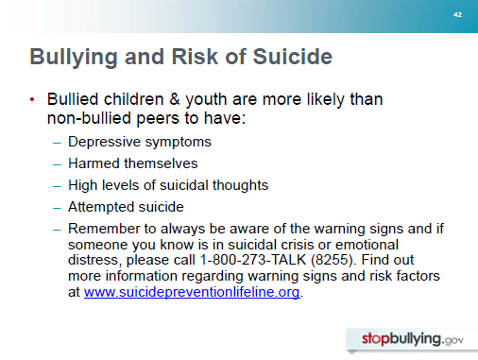
Notes:
Children and youth involved in bullying are more likely than their non-bullied peers to suffer depression, but they also are more likely to:
have harmed themselves (i.e., hurt themselves without intending to die)
have high levels of suicidal thoughts
have attempted suicide
Additional Information:
Those who are bully-victims (those who are bullied and also bully others) appear to be at the highest risk.

Slide 43
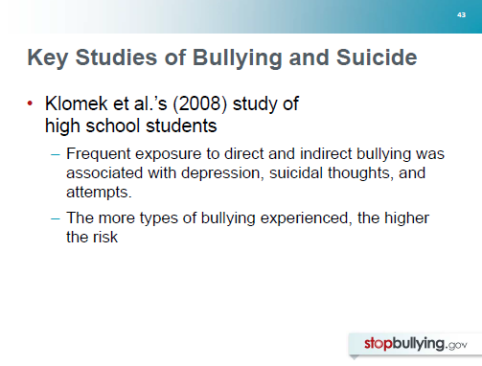
Notes:
Additional Information:
Klomek and colleagues studied 2,300 high school students and found that frequent exposure (once per week or more often) to different types of bullying (e.g. physical bullying, being belittled about looks or speech, being the subject of rumors or mean lies) was associated with a high risk of depression, suicidal thoughts and suicide attempts, compared to non-bullied students. And, the more types of bullying experienced, the higher the risk.
Reference:
Klomet, Marrocco, Kleinman, Schoenfeld, & Gould (2008)

Slide 44
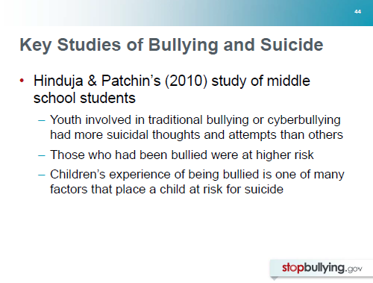
Notes:
Additional Information:
Hinduja & Patchin (2010) studied 2,000 middle school students and found that:
youth involved in traditional bullying or cyberbullying (either as offender or as victim) had more suicidal thoughts and suicide attempts than others;
children who had been bullied were at higher risk than those who had bullied others; and
children’s experience with bullying was one of many factors that place a child at risk for suicidal thoughts and behaviors.
These researchers remind us that tragically, suicide is one of the leading causes of death among young people in the U.S. Although children who are involved in bullying are at higher risk of suicidal thoughts and behavior, there are many individual, relational, community, and societal factors that contribute to risk of suicide among youth.
References:
Centers for Disease Control (2009)
Hinduja & Patchin (2010)

Slide 45
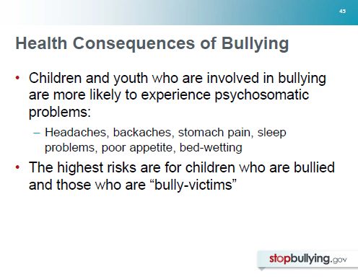
Notes:
Children who are involved in bullying are also more likely than their peers to exhibit health problems, such as headaches, backaches, stomach pain, sleep problems, poor appetites, and bed-wetting. Because health concerns such as these are tied to psychosocial factors, they are frequently referred to as “psychosomatic” problems.
Additional Information:
Children and youth who show the greatest likelihood of these health problems are those who are bullied and those who are referred to as bully-victims. On average, these children (victims and bully-victims) are twice as likely as non-bullied children to exhibit psychosomatic problems. (Children who bully others also have slightly higher rates of these problems than non-bullied children, but to a lesser extent than children who are bullied.)
References:
Fekkes, Pijpers, & Verloove-VanHorick (2004)
Gini & Pozzoli (2009)

Slide 46
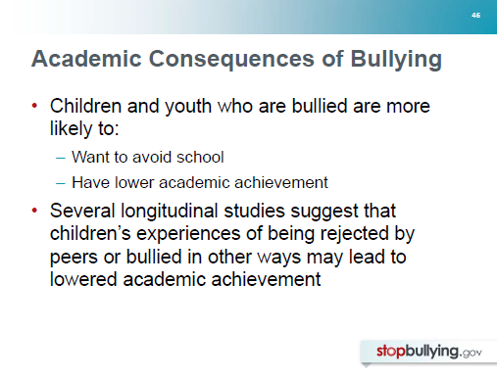
Notes:
Not only do many children and youth suffer mental health and health consequences from bullying, but they also may experience academic consequences as well.
Children and youth who are bullied are more likely than non-bullied peers to want to avoid going to school. They also are more likely to have somewhat lower academic achievement, whether measured through grades or standardized test scores.
Additional Information:
In addition, several longitudinal studies—which measure children’s experiences of bullying over time—suggest a causal relationship between bullying and academic achievement. For example, in a recent study of students in the U.S., middle schoolers’ grade point averages and levels of academic engagement were predicted by whether or not they had been bullied. The researchers concluded that the effect of bullying could account for up to 1 ½ letter grade decrease in an academic subject over the 3 years of middle school (Juvonen et al., 2011).
References:
Buhs, Ladd, & Herald (2006)
Buhs, Ladd, & Herlad-Brown (2010)
Juvonen, Wang, & Espinoza (2011)
Kochenderfer & Ladd (1996)
Nakamoto (2009)
Rigby (1996)
Smith, Talamelli, Cowie, Naylor, & Chauhan (2004)

Slide 47
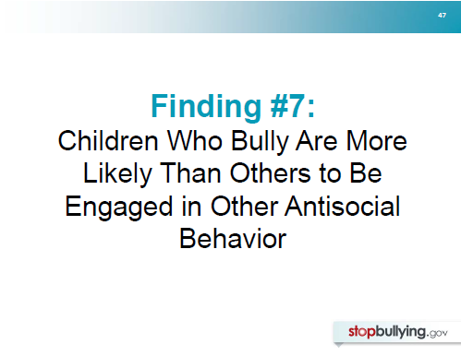
Notes:
Not only is there reason to be concerned about children who are bullied, but there also is reason to worry about children who bully others. They are more likely than other children to be involved in antisocial and troubling behavior.

Slide 48
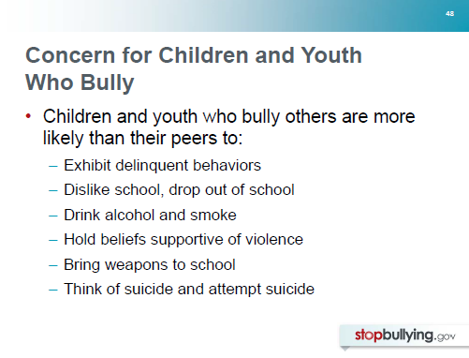
Notes:
Children and youth who bully others are more likely than their peers to:
Exhibit delinquent behaviors (such as fighting, stealing, vandalism)
Dislike school and drop out of school
Drink alcohol and smoke cigarettes
Bring weapons to school
Think about and attempt suicide
References:
Berthold & Hoover (2000)
Byrne (1994)
Cook et al. (2010)
Klomek et al. (2008)
Nansel et al. (2001)
Nansel et al. (2004)

Slide 49
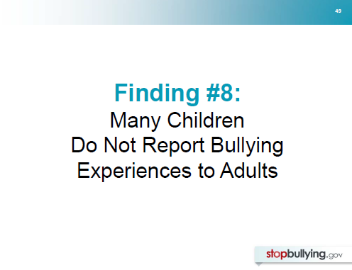
Notes:
An eighth research finding involves the likelihood that children and youth will report bullying to adults if they experience it.

Slide 50
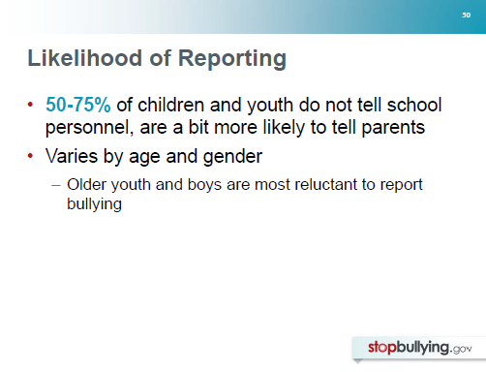
Notes:
Unfortunately, most studies suggest that the majority of children and youth who have been bullied (50-75% in most studies) have not told an adult at school. Somewhat more indicate they have told a parent, but many are silent.
Additional Information:
The likelihood that a child will tell someone about their bullying experiences varies by age and gender. Older youth and boys are less likely than younger children and girls to report that they have been bullied.
References:
Boulton & Underwood (1992)
Fonzi, Genta, Menesini, Bacchini, Bonno, & Constable (1999)
Harris, Petrie, & Willoughby (2001)
Olweus & Limber (2010)
Whitney & Smith (1993)

Slide 51
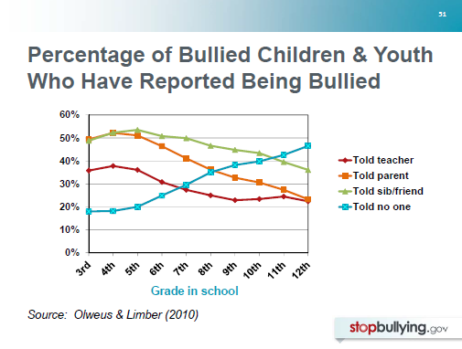
Notes:
For example, in a study of more than 520,000 students in grades 3-12 in the U.S., Olweus & Limber (2010) found that with age, it was less and less likely that bullied children and youth would tell a teacher or other school personnel, a parent, or a sibling or friend.
With age, it was more and more likely that they would tell no one about their troubles.
Reference:
Olweus & Limber (2010)

Slide 52

Notes:
There likely are numerous reasons why children and youth are reluctant to report being bullied. Particularly for older children and youth, they may fear being labeled “tattlers” or “snitches” by their peers. Many likely are concerned about possible retaliation by their aggressors if they report them.
Additional Information:
Boys may feel pressure to try to deal with bullying on their own so as not to appear “weak” or vulnerable. Some may lack confidence in adults’ abilities to stop the bullying. Research suggests that with age, students are less and less likely to perceive that adults are helpful in stopping bullying.
As a result, it is critical that adults respond quickly, effectively, and sensitively when bullying is reported to them and that they are vigilant to possible bullying that is not reported, particularly among older youth and boys.
References:
Fonzi et al. (1999)
Hoover, Oliver & Hazler (1992)
Olweus & Limber (2010)

Slide 53

Notes:
Some good news to share is that many children and youth are concerned about bullying.

Slide 54

Notes:
Research confirms what many parents and educators believe, which is that most children and youth don’t like bullying and feel sorry for their peers who are bullied.
Additional Information:
In one study (Olweus & Limber, 2010), researchers found that 90% of 3rd-5th graders said they felt sorry for students who are bullied. With age (in to middle and high school grades), fewer and fewer students expressed sympathy for bullied students, and girls were more likely than boys to say they felt sorry for bullied peers.
References:
Baldry (2004)
Olweus & Limber (2010)
Rigby & Slee (1993)

Slide 55

Notes:
Unfortunately, this sympathy often does not result in positive action to help stop the bullying. In one study (Olweus & Limber, 2010), researchers found that even though the vast majority of elementary school children felt sorry for bullied students, fewer than half said they would try to help if they saw or knew that a student was being bullied (Olweus & Limber, 2010).
Additional Information:
Peers’ actions appear to vary by age and gender. Several researchers have found that younger children and girls are not only more likely to report bullying that they know about, but by self-report, they also are more likely to respond—for example, by directly stepping in to help the bullied student or telling the aggressor to stop.
When witnesses do try to help a bullied student, they are often effective in stopping the bullying in the moment. One study found that in the majority (57%) of these cases, the bullying stopped within 10 seconds (Hawkins, Pepler, & Craig, 2001).
References:
Hawkins, Pepler & Craig (2001)
Olweus & Limber (2010)
Trach, Hymel, Waterhouse, & Neale (2010)

Slide 56

Notes:
A final finding to share is that there are a variety of state and federal laws in the United States related to bullying.

Slide 57

Notes:
Schools that receive federal funding (including colleges and universities), are required by federal law to address discrimination based on a number of different personal characteristics.
Additional Information:
Title VI of the Civil Rights Act of 1964 (referred to as Title VI) prohibits discrimination based on race, color, or national origin
Title IX of the Education Amendments of 1972 (referred to as Title IX) prohibits discrimination based on sex
Section 504 of the Rehabilitation Act of 1973 and Title II of the ADA (1990) prohibits discrimination based on disability
Reference:
Ali (2010)

Slide 58

Notes:
School districts may violate federal civil rights laws when:
Peer harassment based on race, color, national origin, sex, or disability is sufficiently serious that it creates a hostile environment, and
The harassment is encouraged, tolerated, not adequately addressed, or ignored by school employees.
It is important to note that although current federal laws don’t protect against harassment based on religion or sexual orientation, they DO include protection against harassment of members of religious groups based on shared ethnic characteristics AND gender-based and sexual harassment of gay, lesbian, bisexual, and transgender individuals.
Additional Information:
School personnel are responsible for addressing bullying behavior that meets this threshold if they know about the behavior or if they reasonably should have known about the behavior.
All school personnel are encouraged to be familiar with information on this topic presented to school personnel in a Dear Colleague Letter from Department of Education’s Assistant Secretary for Civil Rights, Russlynn Ali.
Reference:
Ali (2010)

Slide 59

Notes:
State and local lawmakers have taken action to prevent bullying and protect children. Through laws (in their state education codes and elsewhere) and model policies (that provide guidance to districts and schools), each state addresses bullying differently.
Find out how your state refers to bullying in its laws and what they require on part of schools and districts.
Bullying, cyberbullying, and related behaviors may be addressed in a single law or may be addressed in multiple laws. In some cases, bullying appears in the criminal code of a state that may apply to juveniles.
In December 2010, the U.S. Department of Education reviewed state laws and identified 11 key components common among many of those laws.

Slide 60

Notes:
There are both similarities and some great differences among these state laws. Nearly all state laws require school districts to develop policies on bullying.
Most (but not all) define bullying, but the definitions used by states vary a good deal. Most laws address cyberbullying or bullying using electronic media.
Additional Information:
Most laws require or suggest that district policies address:
Responsibilities of school personnel for reporting and investigating incidents of bullying
Consequences or sanctions for students who bully
How the policy will be communicated to students, parents, and school personnel
Education for staff and students and/or bullying prevention efforts
A minority of the laws address the need for mental health services for children involved in bullying.
Because of the differences in these laws, it is important for educators, other professionals who work with schools, and parents to become familiar with their own state law and school district policy.
References:
Alley & Limber (2009)
Swearer, Alley, & Limber (2009)
U.S. Department of Education (2011)

Slide 61

Notes:
With these key findings about bullying in mind, we will turn now to look at 10 principles or elements of best practices in the prevention of bullying.
The research supporting these elements comes primarily from evaluations of school-based programs and experiences in the field. However, as you’ll notice, we’ve tried to broaden their focus—to provide an idea of best practices in non-school settings as well. There’s good reason to do this.
Bullying among children and youth doesn’t stop at the doors of the school, and bullying prevention efforts are increasingly expanding beyond schools. There is growing evidence that communities that use a public health approach to prevention of issues such as bullying (that includes a focus on health promotion and risk reduction) see the best results.
References:
Swearer et al. (2010)

Slide 62

Notes:
In order to reduce bullying and create positive climates where youth feel safe, emotionally secure and connected, it is important to focus on the social climate of the school, neighborhood center, recreation league, or other setting where children and youth gather.
Additional Information
It must become “uncool” to bully; children, youth, and adults must notice if children are being left out, made fun of or bullied in other ways; and “cool” to step in to be a friend or to help out in other ways if someone is bullied.
Doing so requires a comprehensive effort. It requires positive adult role models who focus on building strong positive relationships among children sand youth.
It takes time, a great deal of commitment and effort on everyone’s part–parents and guardians, teachers, counselors, coaches, police officers, bus drivers, clergy and faith communities, physicians, school and after-school administrators and of course youth themselves.
References:
Hargreaves, Earl, & Ryan (1996)
Mulvey & Cauffman (2001)
Nation, Crusto, Wandersman, Kumpfer, Syebolt, & Dafino (2003)
Olweus (1993)
Olweus & Limber (2010)

Slide 63

Notes:
Adults are not always very good at estimating the nature and prevalence of bullying. Teachers are often surprised by student reports on how often they are bullied or witness bullying, the forms it takes, and the “hot spots” where bullying occurs.
There are various sources of information on the prevalence of bullying in schools and of youth violence in communities (see The Community Action Toolkit).
However, local data can often be more useful in making decisions about community-wide prevention strategies and programs.
Additional Information
There are a number of possible sources for local data. One of the most common is giving students an anonymous questionnaire about bullying.
What are possible benefits of conducting a survey among children and youth? Findings can:
-Help raise awareness and motivate adults to take action against bullying;
-Help leaders monitor where bullying is occurring;
-Help leaders to assess the need for training and tailor training and bullying prevention strategies to the particular needs of the organization;
-Serve as a “baseline” so leaders can measure their progress in reducing bullying.
It can be helpful to collect data – formally or informally – from staff and parents. This is because adults sometimes have different perceptions about bullying than youth themselves.
School personnel should ensure that data collection efforts are consistent with the Family Educational Rights and Privacy Act (FERPA, which applies to any disclosure of personally identifiable information from students’ education records), and the Protection of Pupil Rights Amendment (PPRA, which provides parents with rights relative to the surveying of their minor children).

Slide 64

Notes:
Bullying prevention must be endorsed by school and community leaders. Their full participation is also needed. Programs should not be the responsibility of a single administrator, counselor, or case-manager at a school, after-school, or recreation center. Effective bullying prevention requires buy-in from a majority of the staff and from parents and guardians.
Enthusiasm and support for school-based prevention efforts have been linked to program success.
References:
Payne, Gottfredson & Gottfredson (2006)
Olweus & Limber (2010)

Slide 65

Notes:
Of course, many schools (and other settings where children and youth gather) are working hard not only to address bullying, but also to address and prevent other social and emotional problems.
It is important to remember that doing “more” isn’t necessarily doing “better.” It is also important to coordinate and, where appropriate, integrate prevention efforts. This ensures that messages are consistent and that time, energy, and resources are being well spent.
Bullying prevention efforts seem to work best when they are coordinated by a representative group of staff. Depending on the scope of the effort, this group should reflect the entire school or community group.
For example, safety committees within schools might include an administrator, a teacher from each grade and other school staff, such as school psychologists, counselors, school nurses, librarians, and bus drivers, who can bring diverse perspectives on bullying.
Additional Information
A community coordinating team may include a variety of partners across many disciplines and service sectors (e.g. health and mental health professionals, educators, law enforcement and juvenile justice officers, etc.).
These teams help to ensure that important voices are heard and that all members of the school community are engaged.
Coordinating teams should meet regularly to review local data, plan for the implementation of policies and practices, and measure the effectiveness of efforts over time.
Student/youth advisory groups can be formed in school to promote respect and inclusion, communicate about bullying prevention with their peers, and help develop rules and policies.
References:
Hahn et al. (2007)

Slide 66

Notes:
Well-trained staff are critical to effective bullying prevention.
Adults who teach or work with youth should be trained in bullying prevention and response. This training can help staff understand the nature of bullying, its effects, how to work with others to help prevent bullying, and what policies and rules are in place.
Every adult who interacts with youth also needs to develop skills in how to stop bullying on-the-spot and what to do if bullying is suspected.
Designated adults will need training to follow-up with those involved afterwards.
Additional Information
Various educational tools can be used (staff meetings, one-day training sessions, webcasts and teaching through modeling preferred behavior) to educate staff about bullying trends and best practices in bullying prevention (see the Community Action Toolkit).
References:
Nation et al. (2003)

Slide 67

Notes:
Although many school behavior codes implicitly forbid bullying, many do not address bullying explicitly.
It is important to make clear that bullying behaviors are prohibited and explain what schools or youth organizations expect of all students to be good citizens and allies—not passive bystanders—if they are aware of bullying or students who appear troubled.
Developing simple, clear rules about bullying that are posted throughout schools, agencies, and public places will remind youth not to bully and can help students who are bullied or who are at risk of being bullied.
When children and youth do help out, this should be noticed by adults and reinforced.
On the other hand, when children violate the rules and bully others, non-hostile, developmentally appropriate consequences may be needed to help correct behavior.
Additional Information
Researchers, who have examined elements associated with effective school-based bullying prevention programs, have found that having classroom rules and clear discipline for violations was related to reductions in bullying.
Under state laws, most schools are required to develop policies about bullying.
School personnel should be familiar with their school’s policy and work to improve it if needed. Non-school organizations may also find it helpful to develop bullying policies and may benefit from being familiar with the local schools’ policies.
References:
Olweus (1993)
Olweus & Limber (2010)
Ttofi & Farrington (2009)

Slide 68

Notes:
Bullying tends to thrive in locations where adults are not present or are not on the lookout for it.
Once “hot spots” for bullying have been identified through local data collection efforts, all adults within the school or organization see it as their responsibility to be on the lookout for bullying.
Additional Information
Strategies for supervising young children will differ from those used for adolescents.
It’s important for adults to know how to communicate and instruct youth in age-appropriate ways about bullying. Exchanges may be more instructive with younger children and subtle, yet firm, reminders to adolescents.
Your tone of voice, gestures, and intent should be caring. Be firm, but fair. Show a sincere interest and concern for the child or adolescent.
References:
Olweus & Limber (2010)
Swearer et al. (2010)

Slide 69

Notes:
Follow-up interviews should be held immediately with involved children and, if possible, on the same day.
Interviews are typically held separately with children who are bullied and with those who bully. Interviews with parents of children who are bullied and those who bully should also be held separately.
In some situations, students may need to be referred to mental health professionals in or outside of school settings.
Understanding why youth are motivated to bully is not straightforward.
The risks associated with aggressive, oppositional, and antisocial behaviors stem from many individual, familial, and societal factors.
Just as some abusive behaviors are learned, children and adolescents can also be taught non-hostile alternatives.
With help, they can learn to act differently and not give into their impulses or desires to hurt or control others.
Additional Information:
Emotionally vulnerable children, who have been chronically victimized or traumatized, may be silently coping with their fears and distress.
They may avoid contact with peers and remain isolated as a way to protect themselves.
And yet, their recovery is helped by a willingness to talk about the bullying and a look at feelings of self-blame and worthlessness in a different way.
Youth who are provocative victims or bully-victims may require a combination of response strategies.
References:
HRSA factsheets - Working with young people who bully others: Tips for Mental Health Professionals, Working with young people who are bullied: Tips for mental health professionals, and Misdirections in Bullying Prevention
Merrell et al. (2008)
Olweus & Limber (2010)
Swearer et al. (2010)

Slide 70

Notes:
Bullying prevention efforts should include facilitated small group discussions.
Classrooms can be forums for sharing feelings and different viewpoints, and learning positive social behaviors.
With support from administrators, teachers often see positive results from setting aside time each week or every other week to discuss bullying and peer relationships with students.
During these meetings, youth can come to understand bullying and the harm it causes, gain skills in responding to bullying, and build understanding and empathy.
These meetings also can help form a sense of community in the group, while also giving teachers a better understanding of their students’ concerns.
Anti-bullying themes and messages can be incorporated throughout the school curriculum.
Whether in small groups or through the curriculum, social and emotional learning (SOL) boosts critical thinking, academic achievement, school connectedness, empathy and positive interactions with peers.
References:
Durlak et al. (2011)

Slide 71

Notes:
There should be no “end date” for bullying prevention activities. Bullying prevention should be ongoing in both schools and youth-serving organizations.
Bully prevention is worth it -- but it takes sustained effort and planning. Research shows that the way schools and organizations implement their programs has a big impact on "quality" and "effectiveness."
Organized and well-managed institutions that are committed to planning and implementing programs have the best results in reducing the rates of bullying.
Additional Information:
Good planning is critical but you can never plan for everything.
If a redesign is necessary, the coordinating group can assist by evaluating prevention needs and outcomes, identifying gaps, and ensuring that the appropriate standards are met.
It's also important to remember that community interest and support is not always steady, so consider ways to renew commitments to safeguarding children and youth and creating bully-free communities.
References:
Adelman & Taylor (1997)
Domitrovich, Bradshaw et al. (2009)
Payne et al. (2006)

Slide 72

Notes:
Unfortunately, well-meaning educators and advocates sometimes use bullying prevention and responses strategies that are not supported by research or our understanding of best practices

Slide 73

Notes:
We’d like to show you a video clip in which Dr. Catherine Bradshaw, a national expert in research on bullying and bullying prevention, discusses some of these most common Misdirections in bullying prevention and response.
This video will discuss five Misdirections, they are:
Zero Tolerance
Conflict Resolution & Peer Mediation
Group Therapeutic Treatment
Overstating or Simplifying the Relationship Between Bullying and Suicide
Simple, Short-Term Solutions

Slide 74


Slide 75


Slide 76


Slide 77


Slide 78


Slide 79


Slide 80


Slide 81


Slide 82


Slide 83


Slide 84


Slide 85


Slide 86


Slide 87


Slide 88

Notes:
These are the main stakeholders you should consider including in your community event, but every community is different. Who else can you think to include?

Slide 89


Slide 90

Notes:
These are just a few examples of awareness raising action steps. Does anyone in the group have additional ideas?

Slide 91


Slide 92

Notes:
When using this tool at your community event, you can complete the matrix as a larger group.
Next, use the check marks to assign groups of individuals to smaller, breakout teams to discuss the immediate next steps needed to achieve the goals across the top of the page.
Lastly, assign roles, responsibilities, and deadlines.

Slide 93

Notes:
Now that you have just about completed the training, we want to give you information on next steps, a call-to-action, and the tools and resources that are available in the Community Action Toolkit.

Slide 94

Notes:
It is important to engage a variety of stakeholders in your effort and secure their support from the beginning.
We encourage you to take the information you’ve learned here today to organize a town hall/community event.
Your event will provide a time to gather all of the stakeholders together to kick-off your effort, identify areas of collaboration, understand the resources available in your community, and develop a call-to-action.

Slide 95

Notes:
Bullying is an issue that affects everyone, and all community members have important roles to play in addressing and preventing it.
A call-to-action that responds to bullying will include roles and responsibilities for stakeholders from across the community.
Different stakeholders can also contribute unique resources and expertise to your community-wide efforts.
The Action Planning Matrix in the Community Action Toolkit will help your participants understand their roles in the effort.
When developing your call-to-action, it is important to be aware of your timeline and resources. This will help you adhere to plans and achieve your goals.

Slide 96


Slide 97

Notes:
Using this Toolkit will help your create a multi-faceted, long-term bullying prevention effort that involves key stakeholders in your community.

Slide 98

Notes:
Landscape Assessment
The first item in the toolkit is a landscape assessment.
This tool will help you gain an understanding of how bullying affects your community and what’s needed to address it.
Completing the Landscape Assessment is a critical first step because it helps you understand efforts already underway and how your initiative can complement these activities.
Having a full understanding of what already exists helps build trust with community members.
This tool includes information on how to use data to understand bullying, determine community perceptions about bullying, assess existing bullying prevention strategies and capacities
selecting community settings and use what you learned to inform next steps.
Template Community Event Agenda
The next item is a Template Agenda to guide the format of your event. Based on your learnings from the landscape assessment, this can be tailored to your community and event participants. The agenda includes time to:
Introduce key research on bullying and do’s and don’t’s for preventing and responding to it
Lead interactive group discussions and brainstorms to develop a call-to-action
Evaluate the event
Each agenda item also includes recommended resources from this PPT, as well as the Community Action Toolkit.

Slide 99

Notes:
Community Engagement Tip Sheet
This tip sheet will provide you with quick tips on how to create and sustain an ongoing bullying awareness and prevention effort.
It includes information on which community stakeholders should be invited to your event and tips for marketing the event. It also includes recommendations, such as building partnerships, using social media, and working with local newspapers and media outlets.
Guide to Mobilizing Communities in Bullying Prevention
This is a checklist of stakeholders to consider engaging in your initiative. There are blank spaces in the document where you can list additional groups that you may want to involve.

Slide 100

Notes:
Action Planning Matrix
Once you have completed the landscape assessment, you will have what you need to complete the action planning matrix.
The matrix is a tool which will help you identify the tangible action steps that stakeholders can take to prevent and stop bullying.
This tool will inform the development of a call-to-action.
For example, law enforcement officials may be best equipped to provide information on state and local bullying laws, while school administrators and educators could be best suited to create an anonymous reporting system in schools.
Tips For Working With The Media
Media are both an important audience and key communicator of bullying issues.
This tool provides helpful tips for engaging media on bullying prevention efforts through proactive outreach.
It also includes a tutorial for writing and distributing your own press release.
Bullying and Suicide: Cautionary Notes
Suicide is a sensitive topic that requires extra care and caution when discussing it within the context of bullying.
This resource provides an overview of bullying and suicide issues.
It also includes approaches to avoid when addressing the topic.

Slide 101

Notes:
Funding Ideas for Future Bullying Prevention Efforts
This resource provides advice and information for funding future events to keep your bullying prevention efforts going strong.
Some examples of potential local funders include economic and rotary clubs, Chambers of Commerce, and local employers.
StopBullying.gov Resources
There are a variety of free bullying prevention and response resources available at www.StopBullying.gov.
This comprehensive inventory includes federal and non-federal training materials, evidence-based program directories, articles, and other tools that you may find helpful in addressing bullying and identifying response and prevention strategies.
Included below is a step-by-step guide to help you access these resources, navigate the directory efficiently and effectively, and submit research-based tools and best practices that have helped address the issue of bullying in your community.
Feedback Forms
The last item in the Community Action Toolkit is a packet of feedback forms which will be used to measure the success of this training and will help you understand the impact of your own community efforts
The next section of the training looks at each feedback form in greater detail.

Slide 102


Slide 103

Notes:
Any community-based initiative—including this one—benefits tremendously from understanding the impact of your work.
Feedback forms can:
(1) Help us document and analyze the development and actual implementation of our strategies. It helps to answer the question of “what was actually done or implemented?”
(2) Help us determine whether and to what extent we were successful in achieving the outcomes we had hoped for.

Slide 104

Notes:
Understanding the impact of this effort includes several pieces that involve input from you and your community event participants. I’ll describe each in turn.

Slide 105

Notes:
Form A, the form you will complete after the training, will have you assess the quality and usefulness of the training and the toolkit resources in learning how to convene one or several community events and plan prevention strategies.
The form is available online at http://www.surveymonkey.com/s/KFCK7T6.
You will be asked to consider:
Your satisfaction with the training content, flow, length, and delivery of training materials;
The strengths and weaknesses that you perceive in the training module and toolkit, and your suggestions for improvements;
Your thoughts on the overall clarity, ease-of-use, and adaptability of the module and toolkit; and
The extent to which you anticipate using what you have learned to organize a community event.

Slide 106

Notes:
Feedback Form B should be filled out and submitted four months following the training module to assess the extent to which you and you are making progress in your activities.
The form will look at:
What steps have been taken after the event to address and reduce bullying?
What opportunities and challenges have been encountered and how have challenges been addressed?
What additional needs and resources are needed to proceed with next steps in implementing the prevention plans and strategies?

Slide 107

Notes:
Form C, the feedback form for the Community Event, will be used to assess the success of the event and participants’ interest in taking part in bullying prevention efforts.
Participants will be asked to consider:
How much participants have learned about bullying and prevention;
The clarity and usefulness of information and resources provided;
Participants’ plans to implement prevention plans and strategies in their communities, and their comfort or confidence in doing so.

Slide 108

Notes:
Feedback Form D should be distributed four months following the initial community event to gain an understanding of event participants’ support for the communitywide initiative.
The form will look at:
The extent to which individuals have chosen to engage in the bullying prevention initiative
(2) The resources and support community members need to stay engaged and continue their efforts
Major challenges and opportunities in their particular communities

Slide 109

Notes:
Let’s use this time to recap the categories of what we learned today:
Bullying Defined
The Many Forms of Bullying
Ten Key Findings About Bullying
Best Practices in Bullying Prevention & Response
Misdirections in Bullying Prevention & Response
Case Studies: Good Approaches in Bullying Prevention and Response
Project Change and FBI Community Outreach
Action Planning & Group Brainstorm
Stakeholder brainstorm
Awareness raising action steps
Prevention & response methods action steps
Next Steps: Putting What You Learned into Practice
Developing a call-to-action
Using the Action Planning Toolkit
Feedback
Let’s also remind ourselves of what action steps we are taking next to continue our efforts and address bullying in our communities.
Lastly, I want to thank you for participating today and remind you that research-based resources are available for you at www.StopBullying.gov.

